Slide 1
Low Resolution Facial Recognition
Daniel Szurek, Brandon Nguyen

Slide 2
Contents
1.
Background
2.
Proposal
3.
Related Works
4.
Expected Outcomes

Slide 3
Background
Most security cameras use wide angles and are far away from subjects, which is good for surveillance, but bad for identifying individuals. Most of these cameras have a very low resolution when zooming in on an individual, making traditional facial recognition techniques impossible to use. Low Resolution Facial Recognition (LRFR) focuses on solving this problem

Slide 4
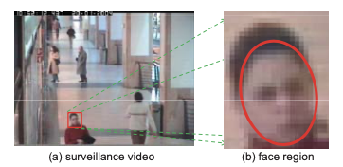
Proposal
We aim to explore lightweight, edge-friendly methods to perform face search with low-resolution queries. We will combine a super resolution model with an advanced lightweight recognition model to improve upon historical LR face recognition rates.

Slide 5



Related Works
A lightweight deep learning model for real-time face recognition
Authors: Zong-Yue Deng, Hsin-Han Chiang, Li-Wei Kang, Hsiao-Chi Li
FN8 Model, 3.5 MB (30x smaller than FaceNet), 1.2M parameters, 0.06 GFLOPS. 99.2% accuracy for 3-sample strategy
We will be using these works, along with others, to establish a basis for our project.
Very Low Resolution Face Recognition Problem
Authors: Wilman W. W. Zou, Pong C. Yuen
Describes a super resolution model that significantly improves upon existing models.

Slide 6
Expected Outcomes
We aim to develop a new, unique pipeline upscaling native low resolution images and sending them to a lightweight model, finding improved recognition rates while also reducing performance cost.

Slide 7
Thank you
&
Questions

